Slide 1

Session : 1
Data Science & AI BOOTCAMP Session
“Our Limit is the Space”

Slide 2




Data Science & AI Board
Eng. Saher Muhamed
Head of Data Science & AI
Eng. Ziad Mostafa
Vice Head of Data Science & Ai
SWE @Shipd || Ex. Data Analyst @ Digitell || Ex. Data Science Intern @ TaQa-Arabia || IBM & Google Certified Data Analyst
Microsoft Certified Data Scientist || Ex. Data Scientist @ ZeNN || Ex. Data Analyst Intern @ ENAKL || Ex. Data Science Trainee @ SHAI For AI

Slide 3












Data Science & AI Core Team
Eng. Mohamed Ashraf
Data Scientist
||BI Trainee @ITI
Eng. Mohamed Shehab Core Team Data Science & AI
@GDG-On Campus ||
Data Analysis Trainee @Growth-Level
Eng. Mostafa Eliwa
Microsoft Certified
Machine Learning @DEPI
|| Second Place At DEPI
Grad-Projects Competition Overall Egypt
Eng. Ibrahim Said Mosa
AI systems member
Technical member at GHOSTECH(2023) event @IEEE-BUB ||
Core Team member
@GDG-On Campus
Eng. Azza Yehya
Kaggle Expert || Data Analyst Trainee @ PEA Learn Company || AI Diploma Graduate @ MEC Academy
Eng. Ibrahim Abdelfatah
Data Science & AI core team member @GDG-BUE || Electrical engineering student || Graduated Data Scientist from DEPI Microsoft SC EELU Data Science student
Eng. Mostafa Sobieh
data analyst|| BI Development internship from ITI || core team & instructor data science & AI @ GDG On Campus
Eng. Habiba Khaled
Microsoft certified data engineer@depiBI trainee@iticoding insrtucor@idevelopercore-team member@gdg on campus
Eng. Wafaa Ahmed
Core team member at GDG BenhaITI trainee
Eng. Mohamed Ashraf
Data Scientist
||BI Trainee @ITI
Eng. Nada Mohamed Data Analyst & Scientist Core team Data Science & AI @ GDG on Campus Trainee to CodeAlpha
Eng. Naira Zidan
Orange certified AI trainee || Old Core-team data analysis

Slide 4












Data Science & AI Core Team
Eng. Ganna Mahmoud
Data Scientist || Core Team Data Science & AI @GDG-On Campus|| BI Trainee @ITI
Eng. Abdelrahman Amr Data Analyst and Scientist || Core Team Data Science and AI @GDG-On Campus || Laptop Maintenance Engineer
Eng. Muhammed Al Reay
Data science & AI @GDG on-campus || IT&Sap Trainee @EIM Group
Eng. Shahd yehia
Core team member @ GDG_On Campus Datacamp certified data analyst
Eng. Reem Kasab
student @BFCAI || Data Science trainee @DEPI || AI member @IEEE ||Data science member @GDG on campus
Eng. Nour Adel
CORE TEAM | DATA SCIENCE AND AI @ GDG ON CAMPUS
Eng. malak Abd Elgwad Core team in Data science &AI@ gdg google developer _on campus.Data science trainee
Eng. Habiba Mohamed
Core team member of Data Science & Ai @GDG- On Campus || Business Intelligence Trainee@ITI ||Member of Ai @IEEE-BUB
Eng. Esraa Adel
Core Team Data Science & AI @GDG ||.Mechanical Engineer(Sealing) member @SailFish RovTechnical member @ IEEE-BUB.
Eng. Niera ElShamy
Core team member Data Science & Ai @GDG-On Campus||Data Analysis&Excel Trainee @itida ||Technical member at"the Egyptian league for Robotics&ai" Competition @CODEAVOUR
Eng. Mohamed Ashraf
Data Analyst
ITI trainee
Eng. Gehad Mohamed
Data Analyst & Scientist Core team Data Science & AI @ GDG on Campus

Slide 5




Data Science & AI Core Team
Eng. Marwan Emam
Core team of Data Science & AI @GDG-On Campus || Ex. Data Science Trainee @ITI
Eng. Jana Walid
Core team data science &AI @GDG On campus
Eng. karima mahmoud IBM Data Scientist trainee @DEPI
Eng. Yasmeen Walid Data Scientist || Data Science Core team @ GDG

Slide 6


What does it mean to you ?

Slide 7

Get ready to code the future🤩🚀

Slide 8
Session Content:
What is Data
Different Data Types
Data Jobs
Data Science Life Cycle
Python Basics
Difference Between Datasets and Data Frames
Python Important libraries
What is Expletory Data Analysis

Slide 9
01. What is Data

Slide 10
- Data: raw information that represents facts, figures, or details about something. It can come in various forms such as numbers, text, images, or measurements. - Data could be represented as a structured and unstructured format
Structured Data: Data that is organized in a predefined format, such as rows and columns, making it easily searchable and analyzable.
Unstructured Data: Data that does not follow a predefined format or schema, making it harder to store and analyze in traditional databases.
Note: Search for a specified Image is a very difficult task in data science and it can be solved using advanced topics such as Machine Learning-Based Search which implement similarity search to search for a specific vector
 | structured | unstructured
Format | Predefined (e.g., tables) | Free-form (e.g., text, media)
Storage | Relational databases (SQL) | NoSQL databases, Data Lakes
Searchability | Easy (e.g., SQL queries) | Complex (requires advanced tools)
Examples | Spreadsheets, Sales Data | Videos, Images, Emails

Slide 11
02. Different Data Types

Slide 12
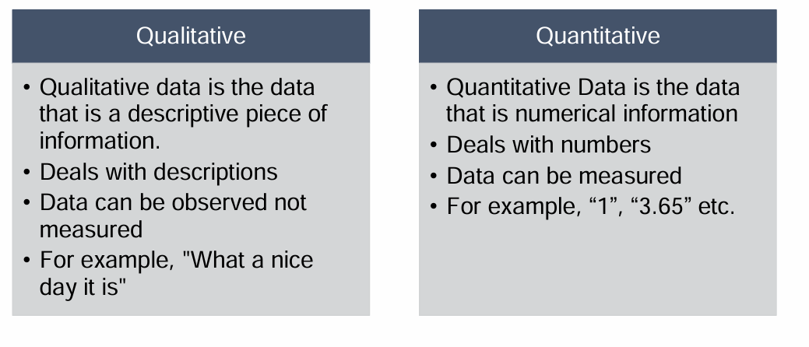
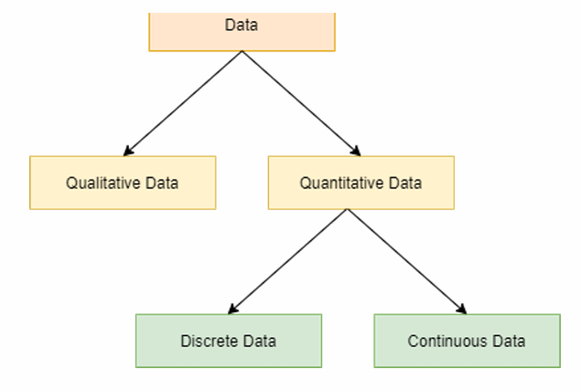
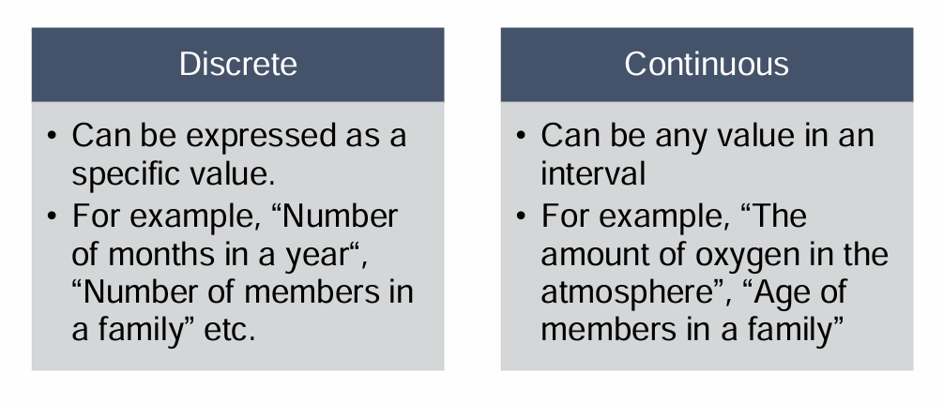

Slide 13
03. Data Jobs

Slide 14
Data Jobs
Data Scientist : Focuses on advanced analytics, predictive modeling, and deriving insights.
Responsibilities:
Build statistical models and machine learning algorithms.
Perform exploratory data analysis (EDA) to find patterns.
Generate actionable insights for decision-making.
Work on unstructured data like text, images, and audio.
Machine Learning Engineer: Focus on building and deploying machine learning systems at scale.
Responsibilities:
Design, train, and fine-tune machine learning models.
Optimize and deploy models in production environments.
Monitor and maintain model performance.
Collaborate with data engineers to ensure data availability.
Data Analyst: Analyzing and interpreting structured data to inform business decisions.
Responsibilities:
Create dashboards, visualizations, and reports.
Perform data cleaning and preprocessing.
Identify trends and patterns in data.
Support stakeholders with actionable insights.
Data Engineer: Building and maintaining the infrastructure for data storage, processing, and accessibility.
Responsibilities:
Design and manage data pipelines.
Ensure data is clean, reliable, and available.
Work with databases, big data technologies, and ETL tools.
Support data scientists and analysts by providing high-quality data

Slide 15
Data Jobs
Feature | Data Scientist | ML Engineer | Data Analyst | Data Engineer
Focus | Insights & models | Deploy ML models | Analyzing data | Data infrastructure
Tools | Python, R, Scikit-learn | TensorFlow, PyTorch | SQL, Tableau, Power BI, Python | Hadoop, Spark
Output | Models & insights | Production models | Reports, dashboards | Pipelines & systems
Key Skills | ML, Statistics | MLOps, ML, DL | Visualization, SQL | ETL, Big Data
End Goal | Predictions & insights | Operationalize AI | Decision support | Data availability

Slide 16
04. Data Science Life Cycle

Slide 17
Data Science Life Cycle
Identification of Problem
Feedback Loop and Iteration
Data Collection
Monitoring and Maintenance
Data Preparation and Cleaning
Model Deployment
Exploratory Data Analysis (EDA)
Model Evaluation and Validation
Feature Engineering
Model Training and Development
Click Here for Article

Slide 18
05. Python Basics

Slide 19
1. Python Variables and Data Structures:
-Variables : Variables in Python different from those in other programming languages by using a unified approach for storing various data types such as strings, integers, floats, and doubles. Unlike some languages, Python allows different data types to be stored using the same variable mechanism.
-List : Ordered and mutable collections of items.
Ex : my_list = [1, 2, 3, 4, 5]
-Dictionaries : Unordered collections of key-value pairs.
Ex:my_dict = {'name': 'John', 'age': 25, 'city': 'New York’}
-Tuples : Ordered and immutable collections of items.
Ex:my_tuple = (1, 2, 3, 4, 5)
-Sets : Unordered and mutable collections of unique items.
Ex : my_set = {1, 2, 3, 4, 5}

Slide 20
2.If condition and Loops in python:
-If condition : used to make decisions in your code based on whether a given condition is true or false. It allows the program to execute different blocks of code depending on the a condition.
EX : x = 10
if x > 5:
print("x is greater than 5")
else: print("x is not greater than 5")
-For loop : Iterates over a sequence or other iterable objects
EX : numbers = [1, 2, 3, 4, 5]
for num in numbers:
print(num)
-While loop: Continues to execute a block of code as long as a specified condition is true
EX : count = 0
while count < 5:
print(count) count += 1

Slide 21
06. Difference Between Datasets and Data Frames

Slide 22
Difference Between Datasets and Data Frames
A dataset is a collection of data, in often organized tabular form, that represents information. It can include various types of data, such as numbers, text, images, or any other data type , While a DataFrame is a specific data structure provided by the Pandas library in Python. It is essentially a two-dimensional, tabular data structure with labeled axes (rows and columns).
Aspect | Dataset | Dataframe
Definition | A collection of data in various forms, such as files, tables, images, or text. | A structured, tabular representation of data with rows and columns.
Format | Can include heterogeneous data types (CSV, JSON, images, etc.). | Strictly tabular, like a table in a database
Structure | Unstructured, semi-structured, or structured | Highly structured (rows and columns).
Usage | Used for diverse data storage and management. | Used for data analysis and manipulation.
Tools | Accessed with file systems, databases, or APIs. | A structured, tabular representation of data with rows and columns. Ex: Pandas
Examples | A folder with images, CSV files, and logs. | Pandas DataFrame: pd.DataFrame(data) in Python.

Slide 23
07. Python Important libraries

Slide 24
NumPy (Numerical Python) is a powerful library in Python that provides support for numerical computations and handling large multi-dimensional arrays and matrices. It is widely used in data science, machine learning, and scientific computing due to its speed, efficiency, and extensive functionality.
1. Numpy
Numpy Popular functions and methods:
Shape : Returns the shape of an array or reshapes it.
head() : and tail() : Returns the first or last n rows of a DataFrame, useful for quick data inspection.
Sum() : Computes the sum of array elements.
Mean() : Computes the mean of array elements.
Max() : Computes the max value
Min() : Computes the min value
Mode() : Computes the most frequent value

Slide 25
Pandas is a powerful Python library designed for data manipulation, analysis, and handling structured data. It is built on top of NumPy and provides easy-to-use data structures and operations for working with labeled data, making it a cornerstone tool in data science and machine learning.
2. Pandas
Operations in Pandas are typically not in place (that is, they return a new modified DataFrame, rather than modifying an existing one) ➢Use the “inplace” flag to make them done in place ➢If you select a single row or column in a Pandas DataFrame, this will return a “Series” object, which is like a one-dimensional DataFrame (it has only an index and corresponding values, not multiple columns)
Pandas Popular functions and methods:
read_csv() : Reads data from a CSV file into a Pandas DataFrame
head() and tail() : Returns the first or last n rows of a DataFrame, useful for quick data inspection.
Info() : Provides a concise summary of a DataFrame, including data types and missing values.
Describe() : Generates descriptive statistics (count, mean, std, min, max, etc.) for numerical columns in a DataFrame
Shape() : Returns the dimensions (number of rows and columns) of a DataFrame.
Value_counts() : Counts the occurrences of unique values in a specified column.
Drop() : Drops specified labels from rows or columns in a DataFrame
Fillna() : Fills missing values in a DataFrame with a specified value or a value derived from a method.
Isna() : provided by Pandas to detect missing values

Slide 26
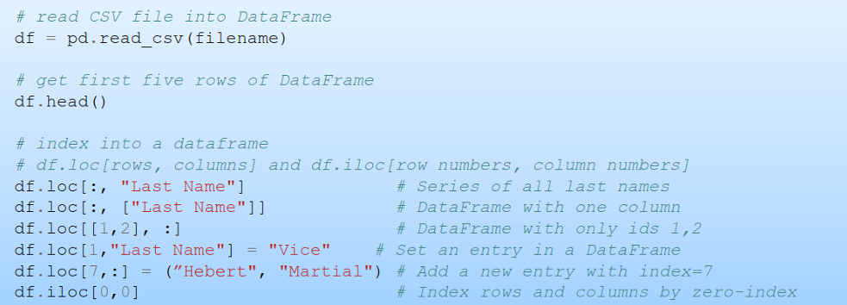
2. Pandas

Slide 27
Matplotlib and Seaborn are Python libraries used for data visualization. They help represent data graphically, enabling better insights and understanding. Matplotlib: is a versatile plotting library that provides control over every aspect of a plot. It is widely used for creating static, interactive, and animated visualizations. Seaborn: is built on top of Matplotlib and provides a high-level interface for creating attractive and informative statistical graphics.
3. Matplotlib and Seaborn

Slide 28
08. Exploratory Data Analysis (EDA)

Slide 29
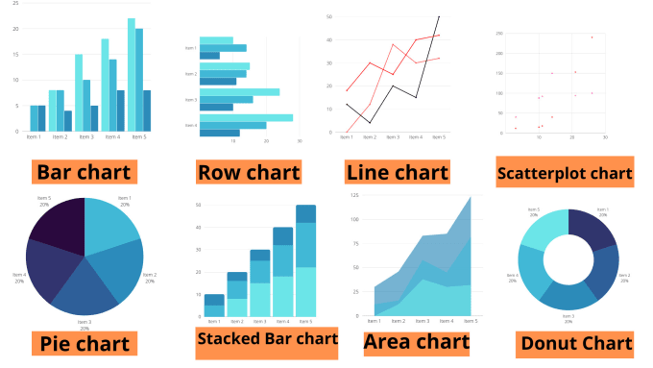
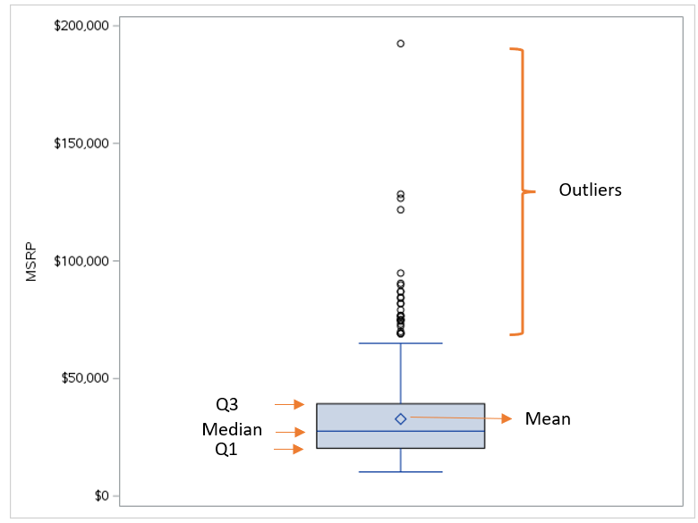
Exploratory Data Analysis (EDA): is the process of analyzing and summarizing a dataset to understand its main characteristics, uncover patterns, and identify anomalies before applying any advanced modeling techniques. EDA helps in gaining insights, formulating hypotheses, and preparing the data for further analysis or machine learning.
Exploratory Data Analysis (EDA)
EDA Steps:
Load and Explore the Data: Understand the data's structure, data types, and sample records
Check for Missing Values: Identify and handle missing data using techniques like imputation or deletion.
Univariate Analysis: Analyze individual Numerical variables using using charts such as Histograms or box plots and Categorical variables using charts such as Bar charts, frequency tables.
Bivariate and Multivariate Analysis: Explore relationships between variables/columns
Outlier Detection: Identify and handle outliers using box plots or statistical methods such as IQR Method
Feature Analysis: Assess the importance and relationships between features for predictive modeling using heatmaps as an example

Slide 30

🤨 Practice Time 🤨

Slide 31

Speaker Time

Slide 32

Our Special Speaker
Eng. Abdelrahman Ashour
Data Science Consultant
Founder of ASD Academy(Discover Data World) || Data Science Consultant @Groupe Seb || Data Analytics || Data Analytics Instructor @MEC Academy || Med Level Data Analyst @DigiTell Dubai || and Data Science team Lead @Najeh || Machine Learning Engineer @Ivy || Data Analyst @CIB Egypt.

Slide 33
We are here for yourself then for our vision !
#1Global

Slide 34
Thanks!
You present GDG Family Not You !

Slide 35
Our Limit Is the Sky🚀 See you Soon !!

